Slide 1

Process Mining Virtual Internship
by
Sreedevi B
Roll No. 214G1A32A2
Department of Computer Science and Engineering (Data Science)
Srinivasa Ramanujan Institute of Technology
(Affiliated to JNTUA & Approved by AICTE) (Accredited by NAAC with ‘A’ Grade & Accredited by NBA (EEE, ECE & CSE)
Rotarypuram Village, B K Samudram Mandal, Ananthapuramu – 515701.
2023 - 2024

Slide 2

Contents
Course Objective
Introduction
Technology
Applications
Modules
Real Time applications
Learning outcomes
GitHub Link
Queries

Slide 3
Course Objective
The course objective for process mining is to teach you how to analyze and improve business processes using data from various sources.
You'll learn how to identify inefficiencies, bottlenecks, and areas for optimization by visualizing and understanding the actual flow of activities within a process.

Slide 4
Introduction
We have done this internship under Eduskills in association with AICTE.
The process mining was done in the platform of Celonis website, it helps companies achieve process excellence through its platform by eliminating operational friction with their Intelligent Business Cloud .

Slide 5
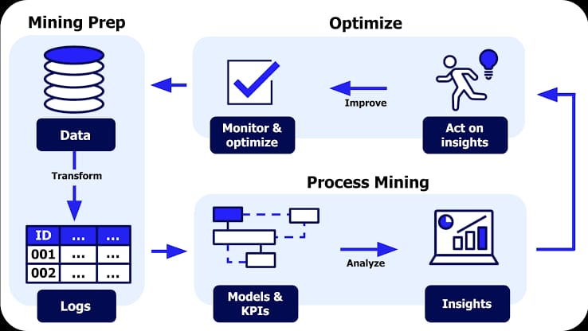
Contd…
Process Mining is a process management technique.This technique is designed to discover, monitor and improve real processes by using available knowledge from the event logs of information systems.
The main use of this process mining technique is to find deviations and weak points in business processes.

Slide 6
Technology
Process mining typically involves the use of various technologies such as data extraction, data transformation, and data analysis. Commonly used technologies include event log extraction tools, data processing platforms, process discovery algorithms, and visualization tools.
Examples of these technologies include ProM, Disco, Celonis, and various machine learning and data analytics frameworks.

Slide 7
Applications
Business Process Improvement: Process mining helps identify inefficiencies, bottlenecks, and areas for improvement within business processes. By analyzing actual process data, organizations can optimize their workflows, reduce costs, and enhance overall efficiency.
Healthcare Optimization: In healthcare, process mining can analyze patient treatment processes, hospital workflows, and resource utilization to enhance patient care,
reduce waiting times, and improve resource allocation.

Slide 8
Modules
Stages of process mining.
How process mining works.
What is needed for implementing
Main components of process mining.
How to start a project in process mining.
Cross-industry use of process mining.
Benefits of process mining.
Applications of process mining.
Best process mining software.
Software providers of process mining.

Slide 9
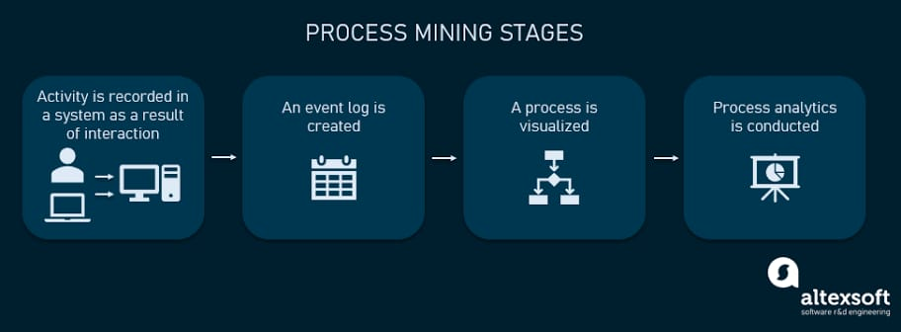
Contd…
Stages of process mining
Main Stages of Process Mining.
1)Interaction
2)Event Log
3)Visualized
4)Process Analysis

Slide 10
Contd…
How process mining works
Collecting Data
Creating Event Logs
Visualizing Processes
Identifying Bottlenecks
Discovering Deviations
Making Improvements
Predicting Future Steps
Continuous Improvement

Slide 11
Contd…
Benefits of process mining
The Process mining save time and increase work capacity that growing demand for efficiency and the ability to clearly present results requires modern technologies.
Finding process bottlenecks which are difficult to uncover through BPM and process mapping workshops.

Slide 12







Coutd…
Software providers of process mining

Slide 13
Real Time Applications
Healthcare Patient Flow : Hospitals can apply process mining to monitor the real-time flow of patients through different departments. This allows healthcare providers to identify bottlenecks in patient care, optimize resource allocation, and enhance the overall patient experience.
E-Commerce Order Fulfillment : In an online retail setting, process mining can track the real-time journey of an order, from placement to delivery. It helps identify any delays, inefficiencies, or errors in the fulfillment process, enabling quick corrective actions.

Slide 14
Learning Outcomes
Gain an overall understanding of basic Process Mining concepts.
Become familiar with Mining core services and tools.
Learn the architectural principles of the process Mining.
Understand and be able to explain Process Mining and compliance measures.

Slide 15
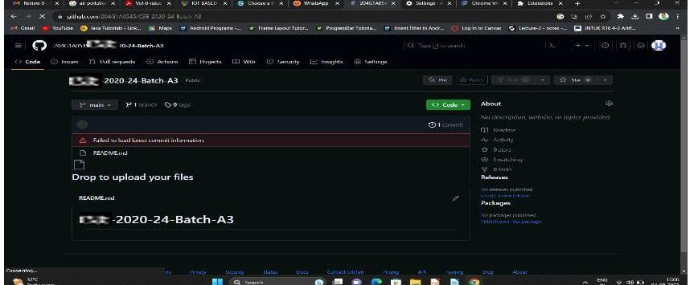

Git Hub Dashboard

Slide 16
Any Queries?

Slide 17
Thank You!!!

